Slide 1
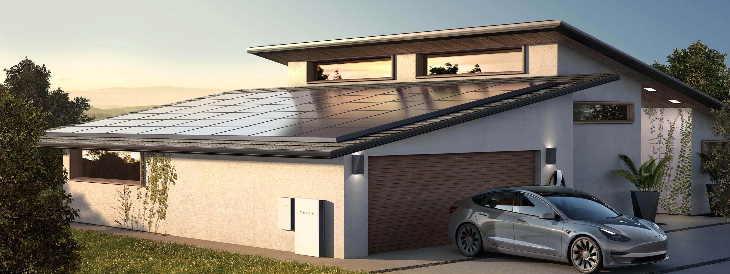




Optimal sizing of solar photovoltaic and lithium battery storage to reduce grid electricity reliance in buildings
Han Kun Ren, Malcolm D. McCulloch, David C.H. Wallom

Slide 2
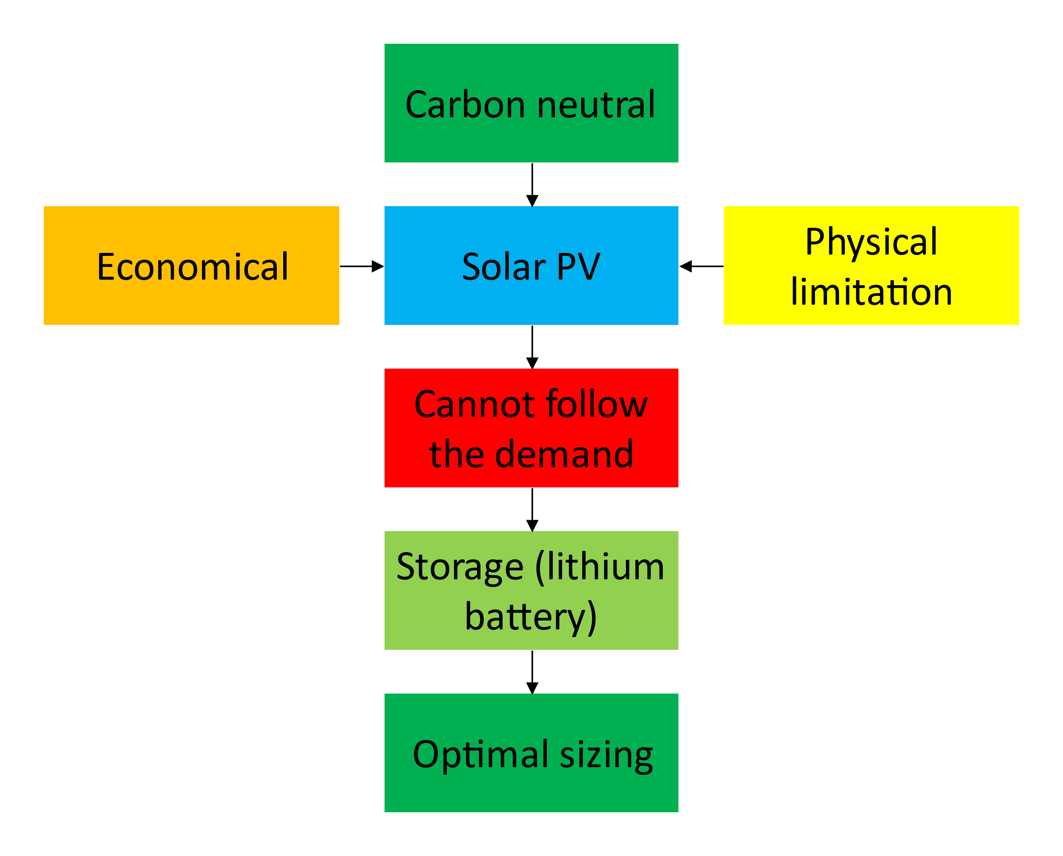
Motivation
1

Slide 3
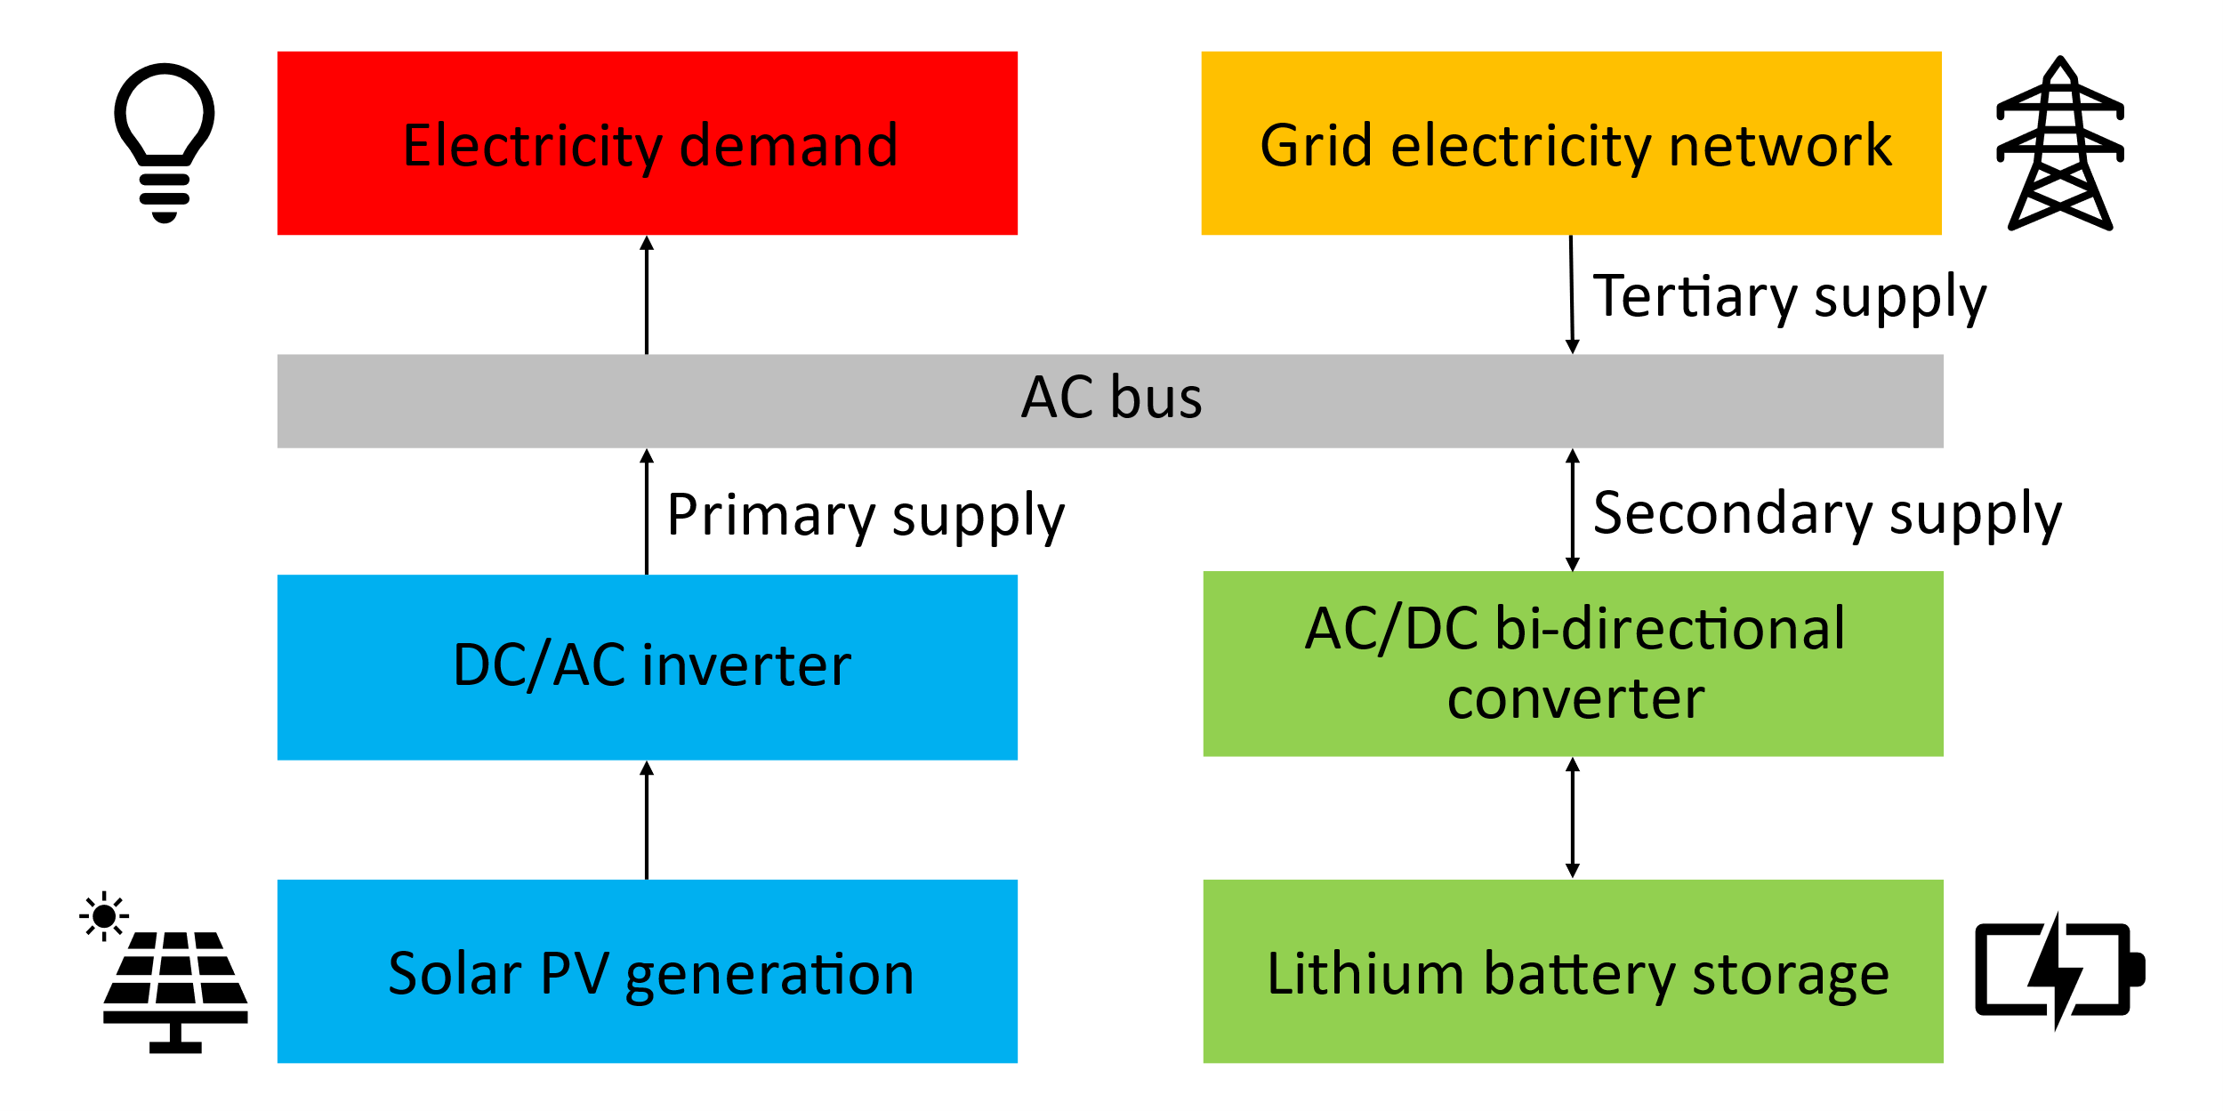
System Setup and Operation Strategy
2

Slide 4
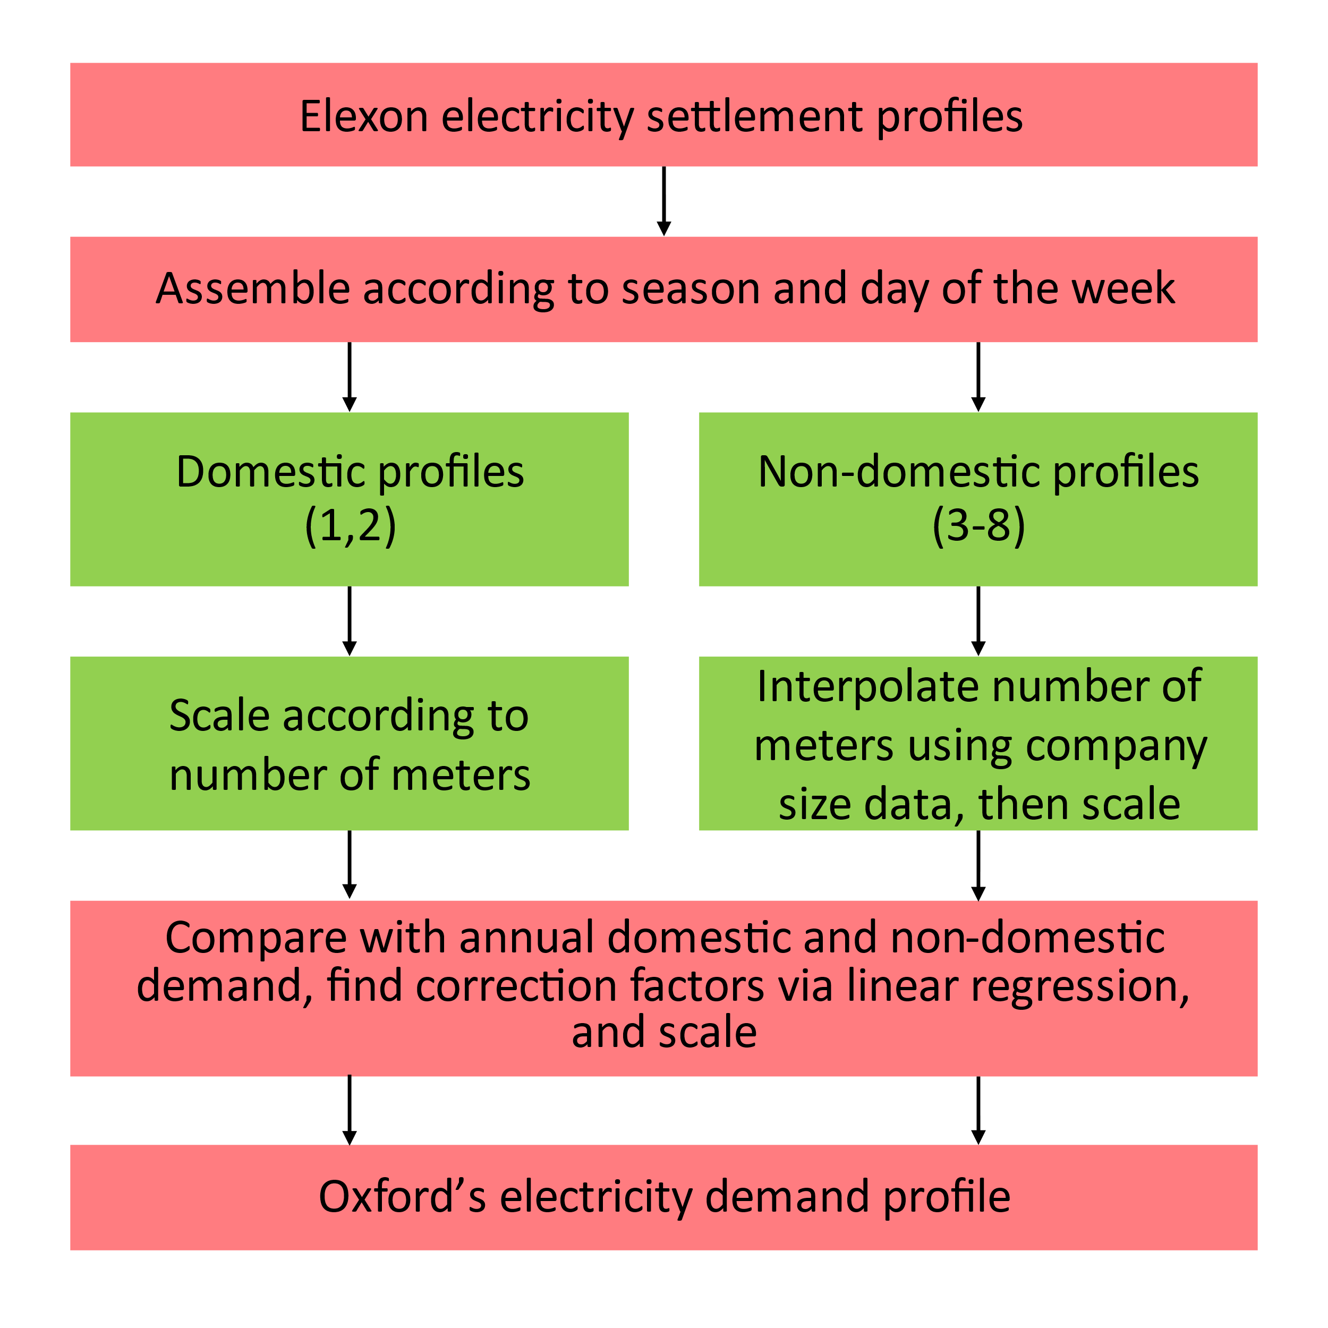
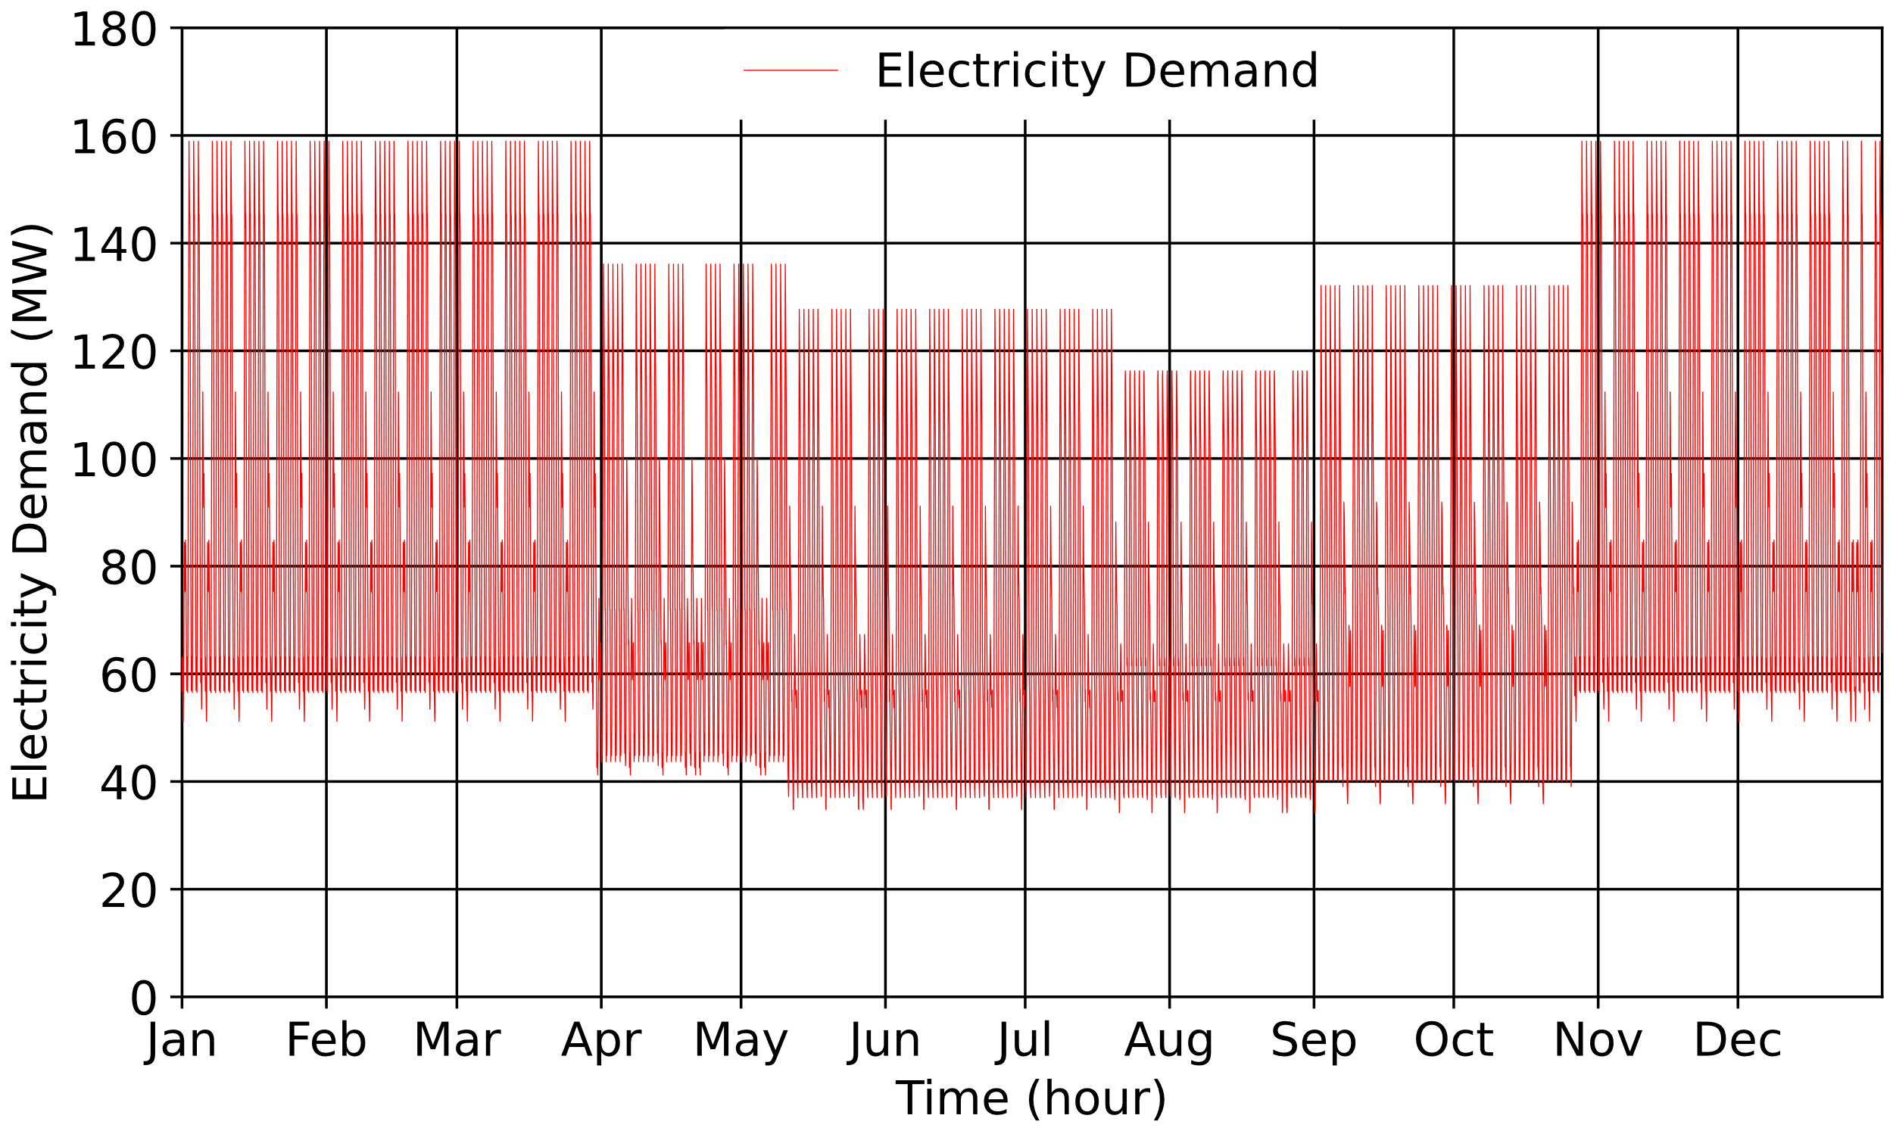
Demand Model
3

Slide 5
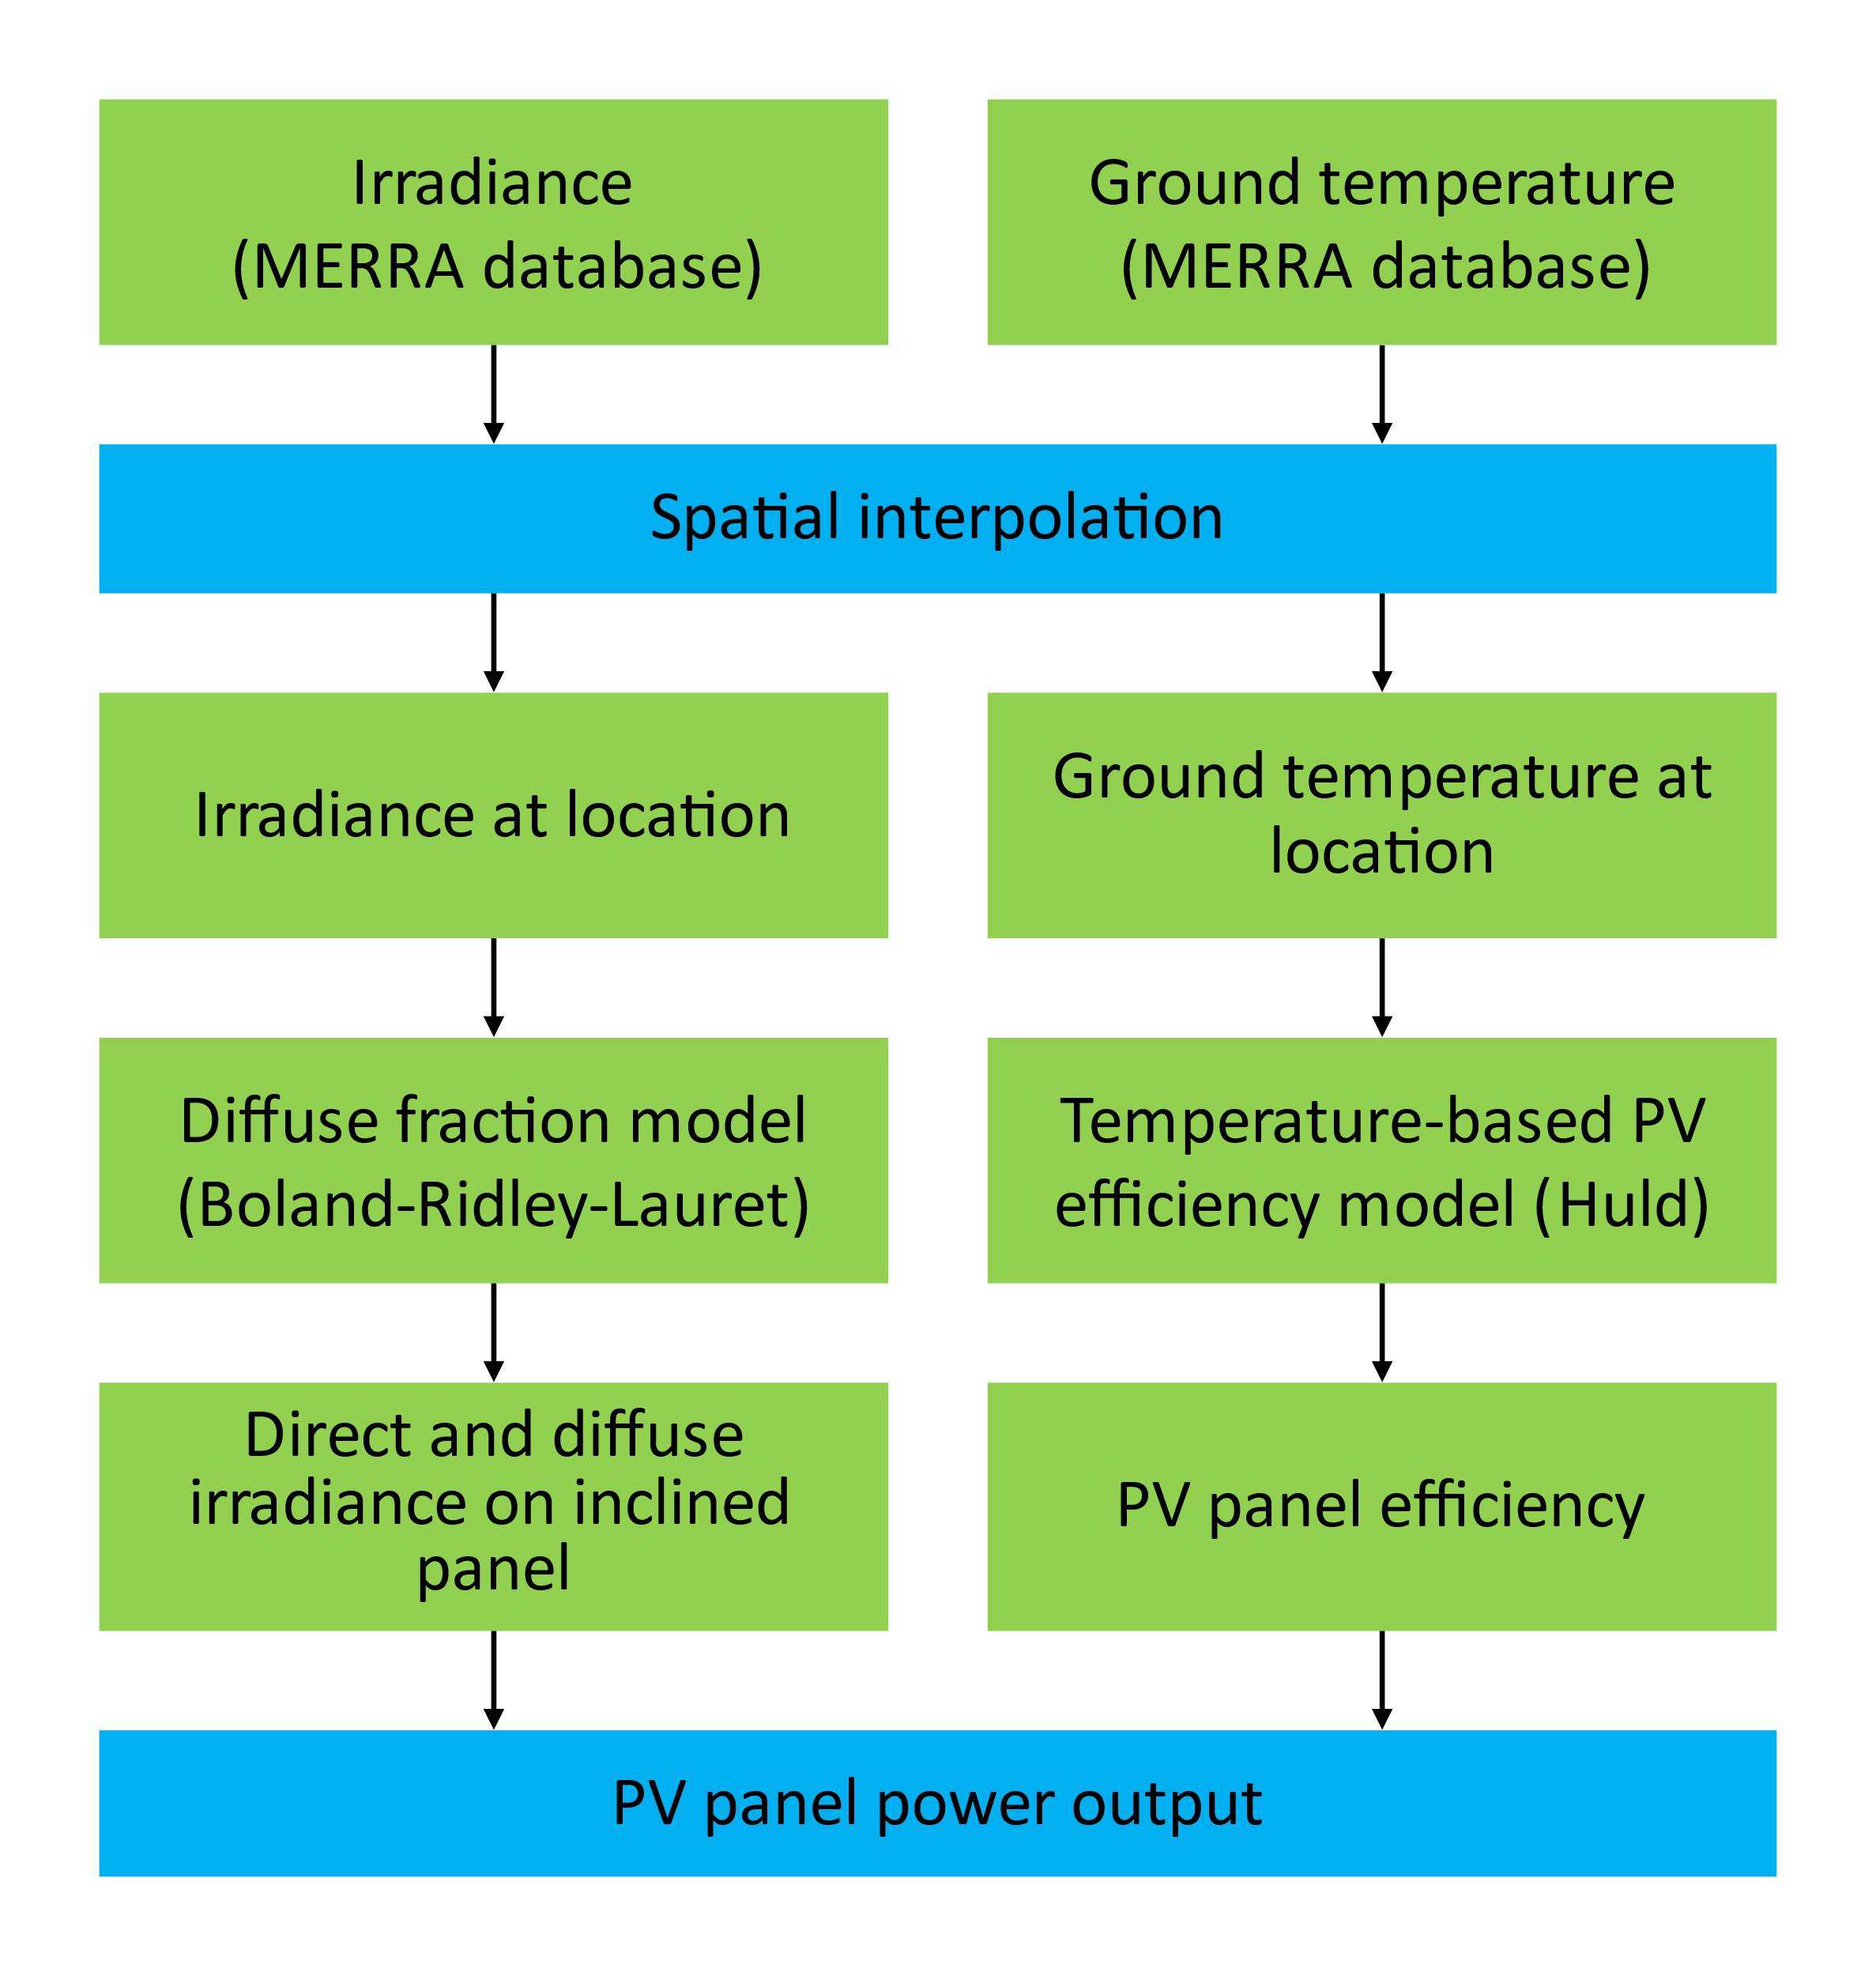
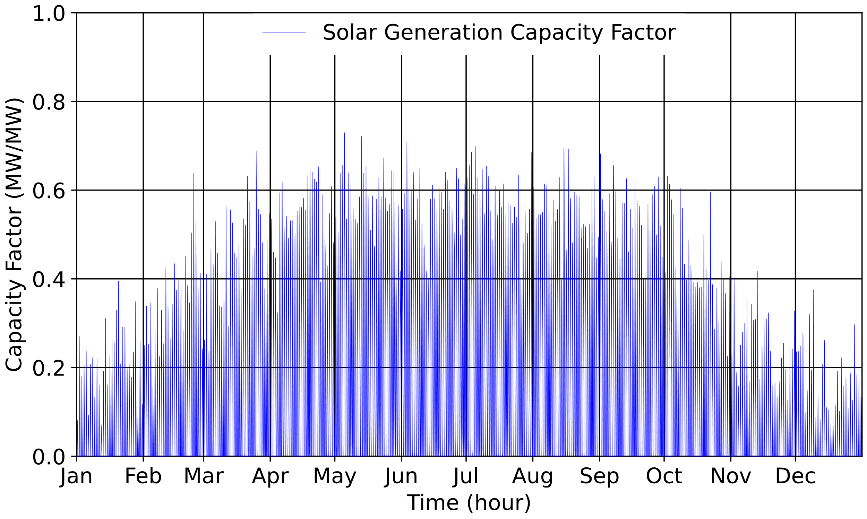
Generation Model
4

Slide 6
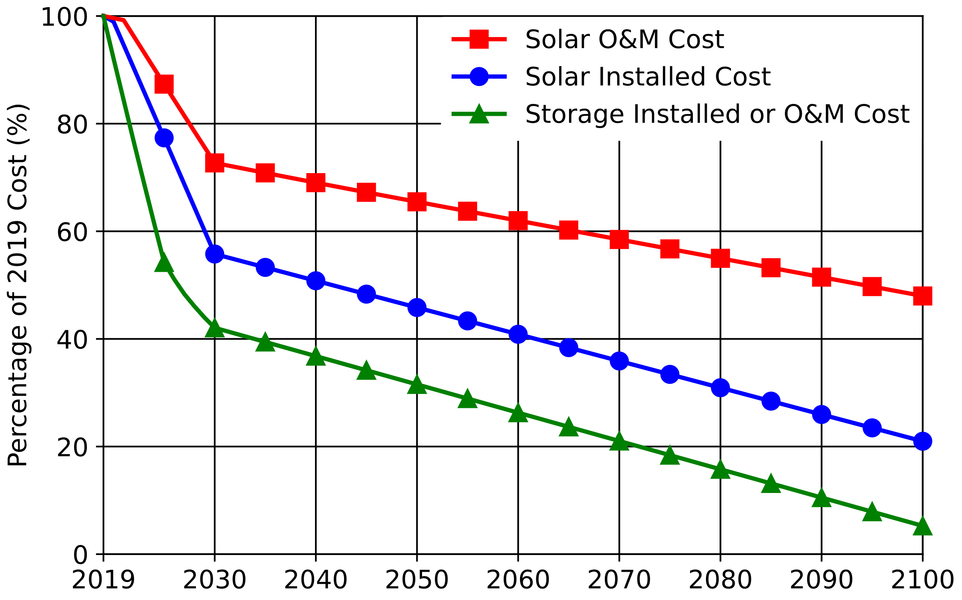
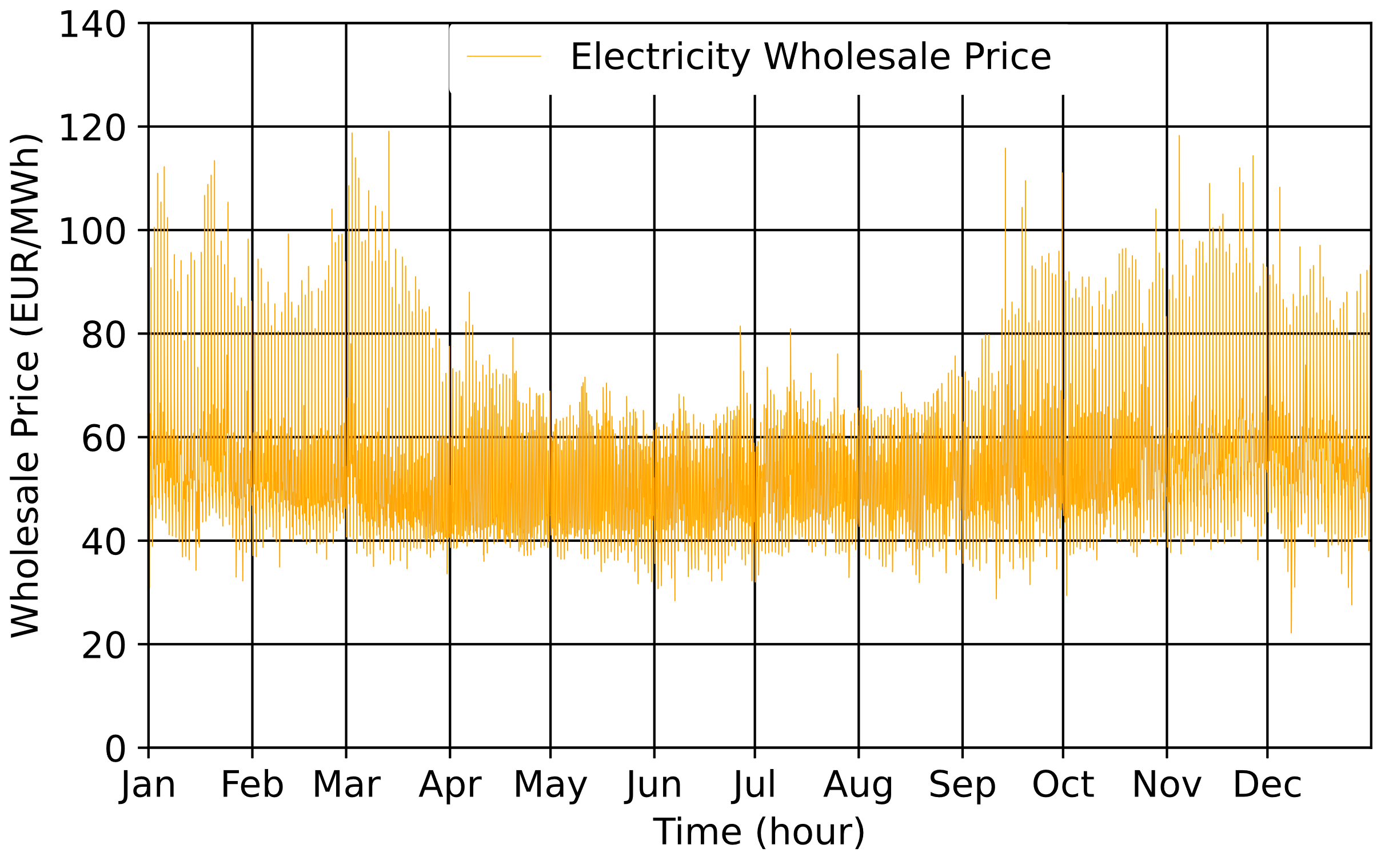
Cost Model
$$LCOE=\frac{Solar Cost+Storage Cost+Electricity Import Cost }{Demand}$$
5
Notes:
Origin of data,

Slide 7
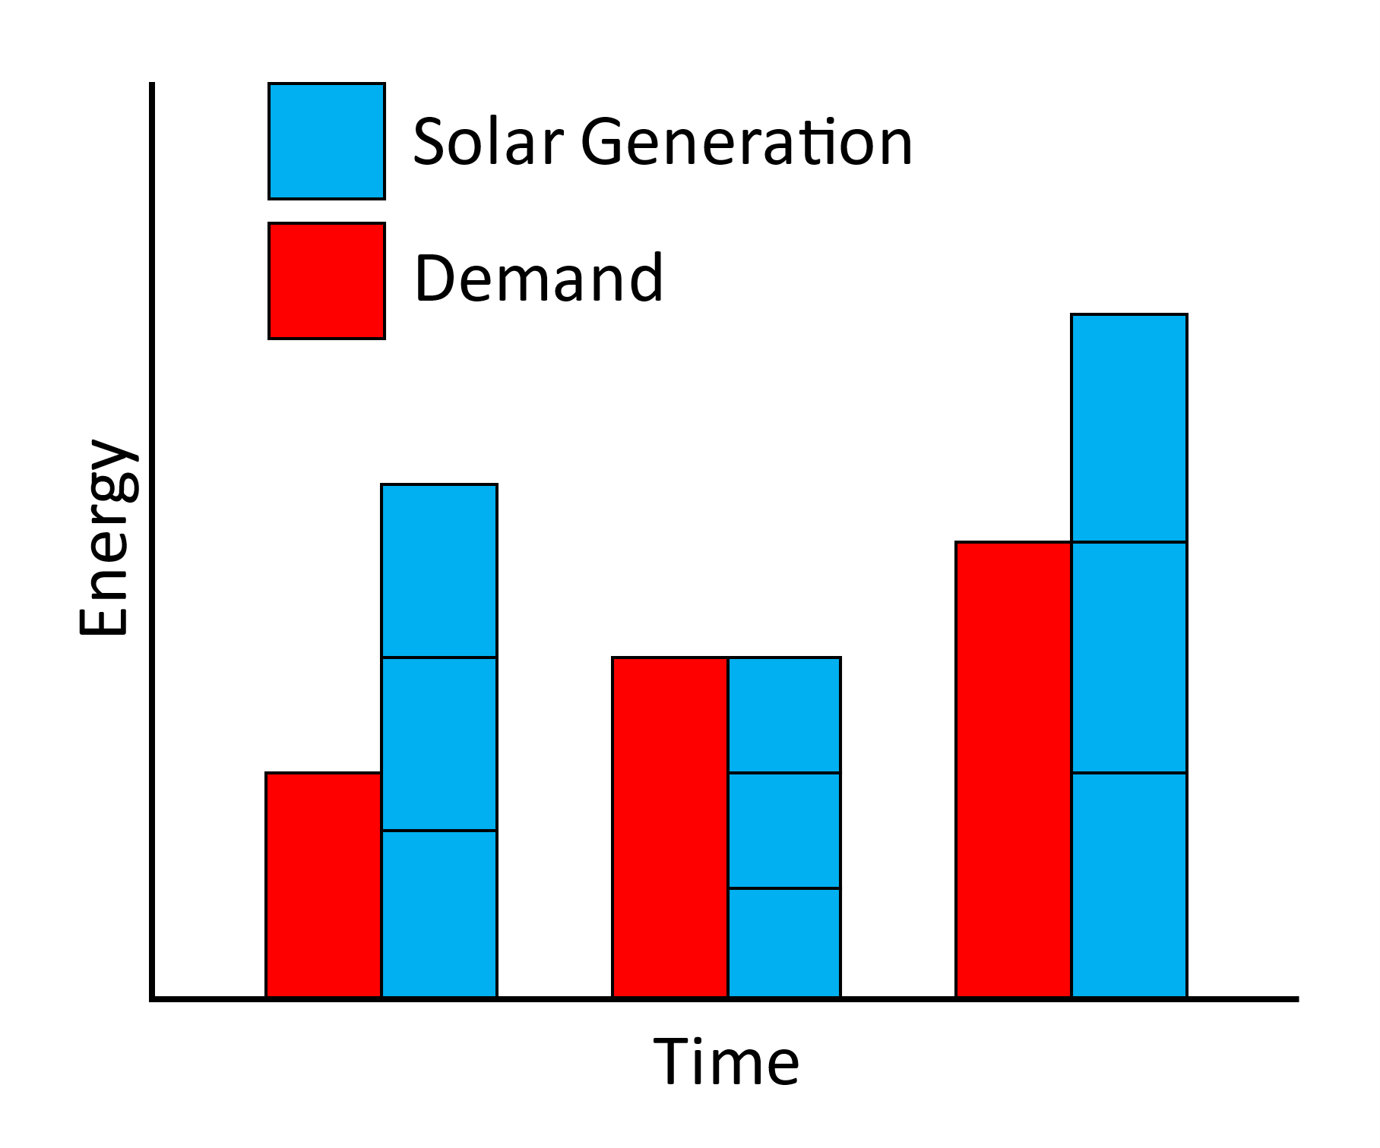
Sizing Method: Solar Size Range
$$Max Solar PV Capacity=Max\left(\frac{Demand}{Capacity Factor}\right)$$
6

Slide 8
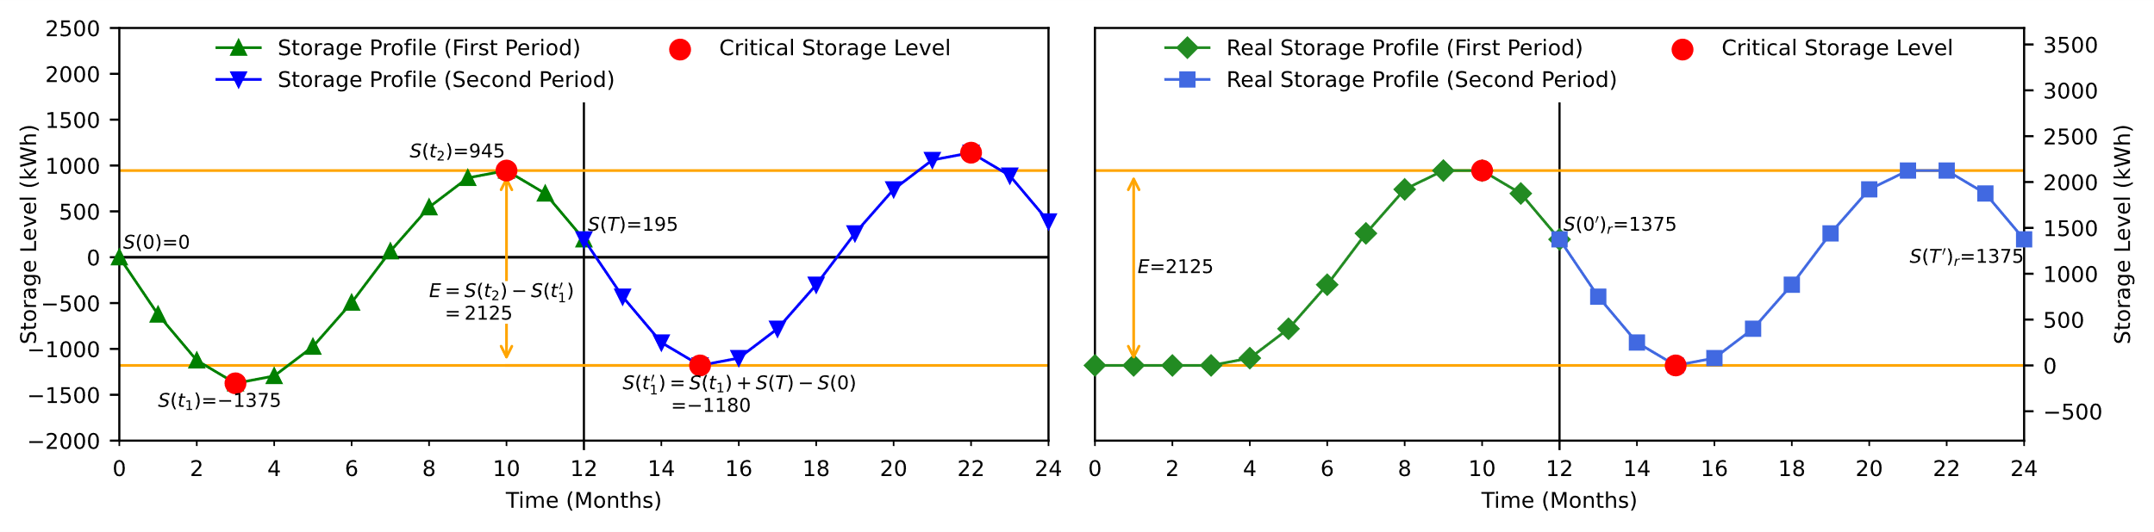
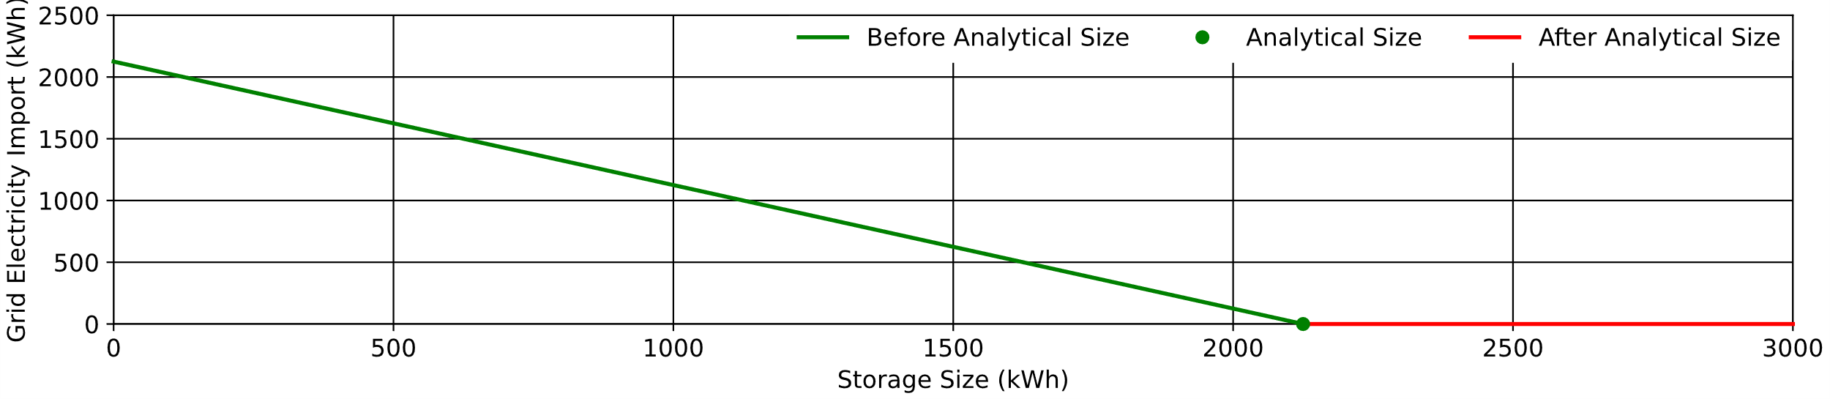
Sizing Method: Storage Size Range
7

Slide 9
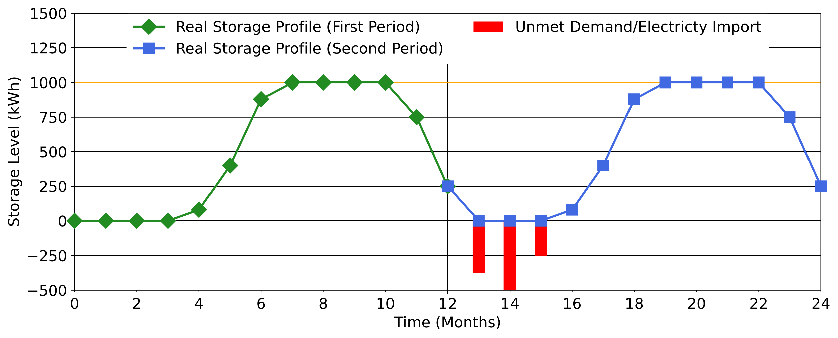
Sizing Method: Electricity Import
8

Slide 10
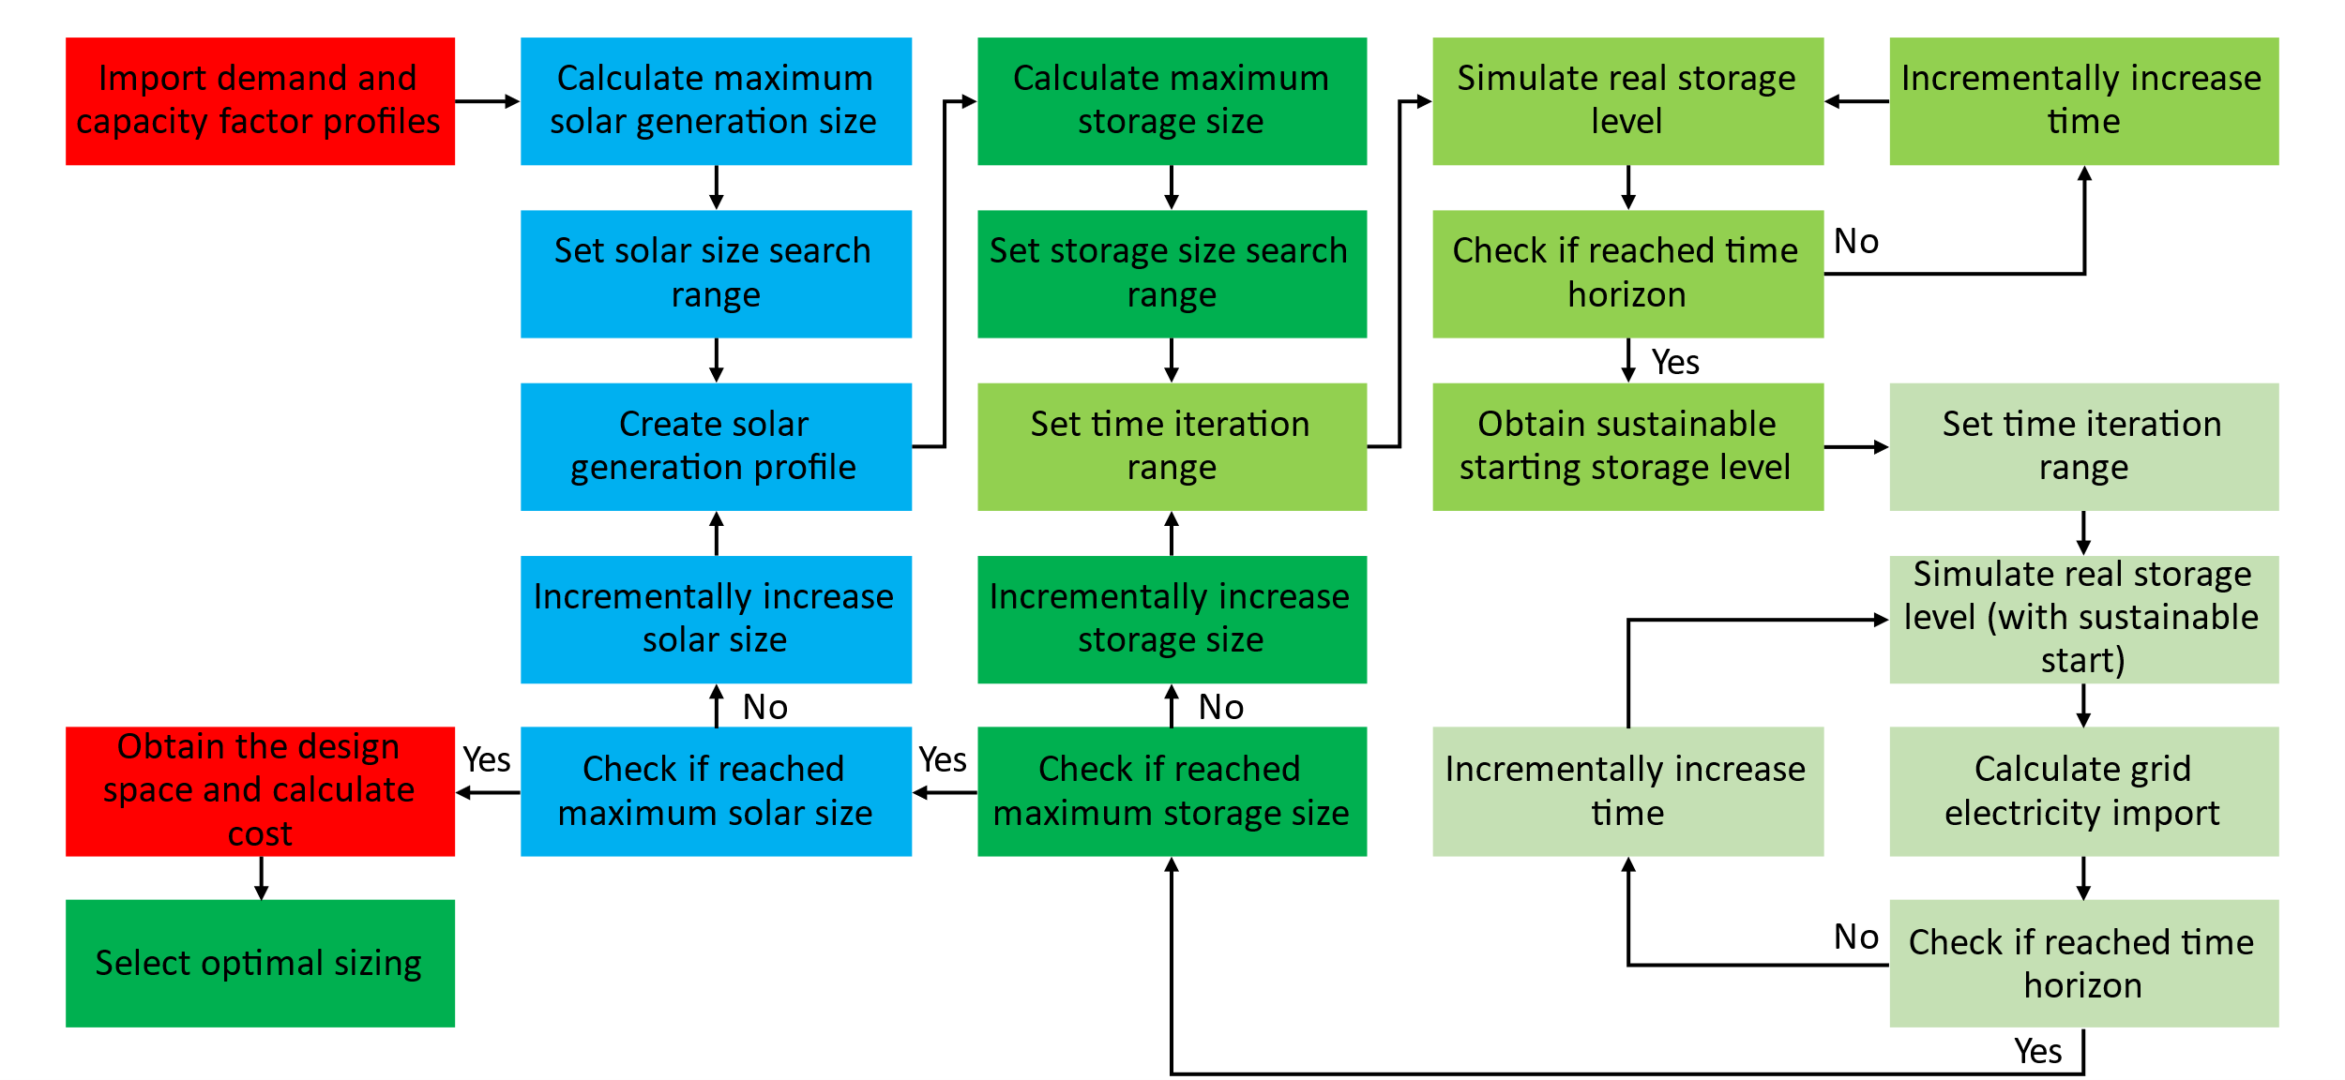
Sizing Method
9
Notes:
Go back to each individual pieces in previously slide (small chunk of the slide)

Slide 11
Sizing Method
9

Slide 12
Sizing Method
9

Slide 13
Sizing Method
9

Slide 14
Sizing Method
9

Slide 15
Sizing Method
9

Slide 16
Sizing Method
9

Slide 17
Sizing Method
9

Slide 18
Sizing Method
9

Slide 19
Sizing Method
9

Slide 20
Sizing Method
9

Slide 21
Sizing Method
9

Slide 22
Sizing Method
9

Slide 23
Sizing Method
9

Slide 24
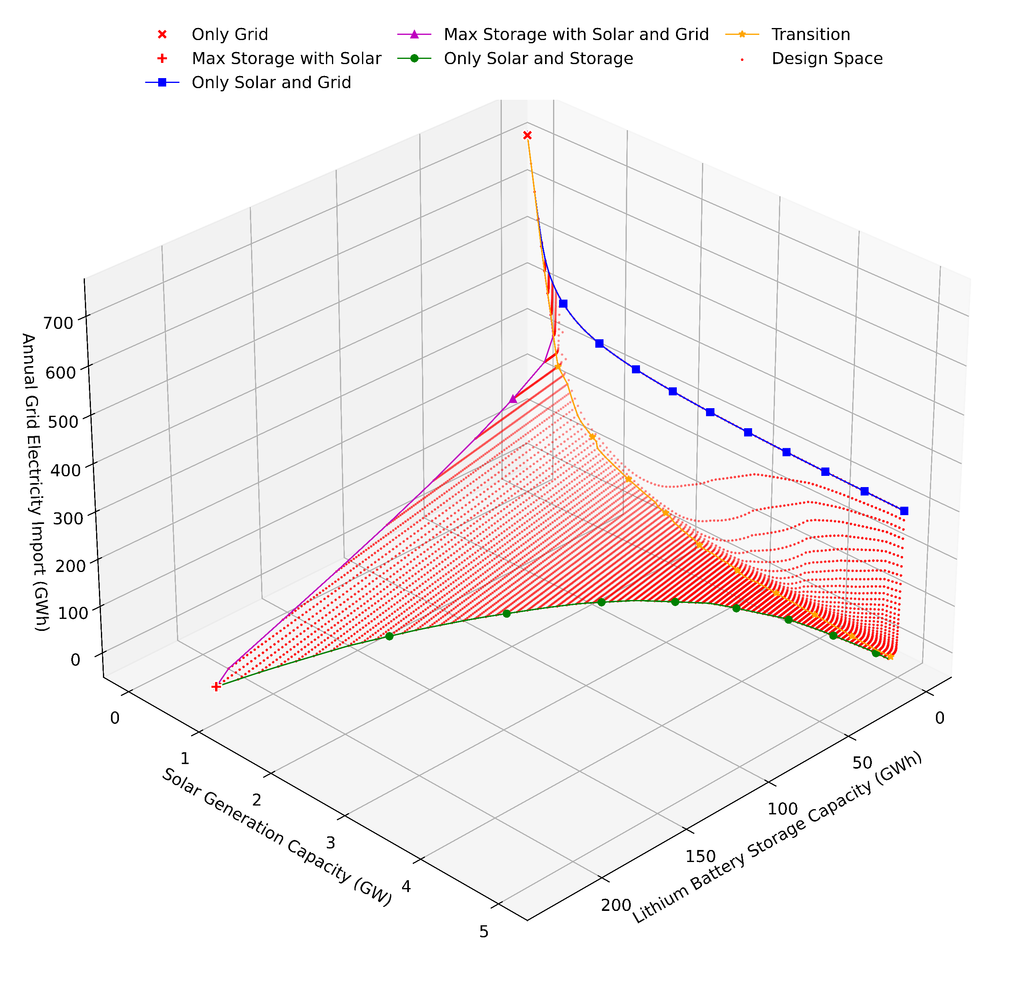
Sizing Method
9

Slide 25
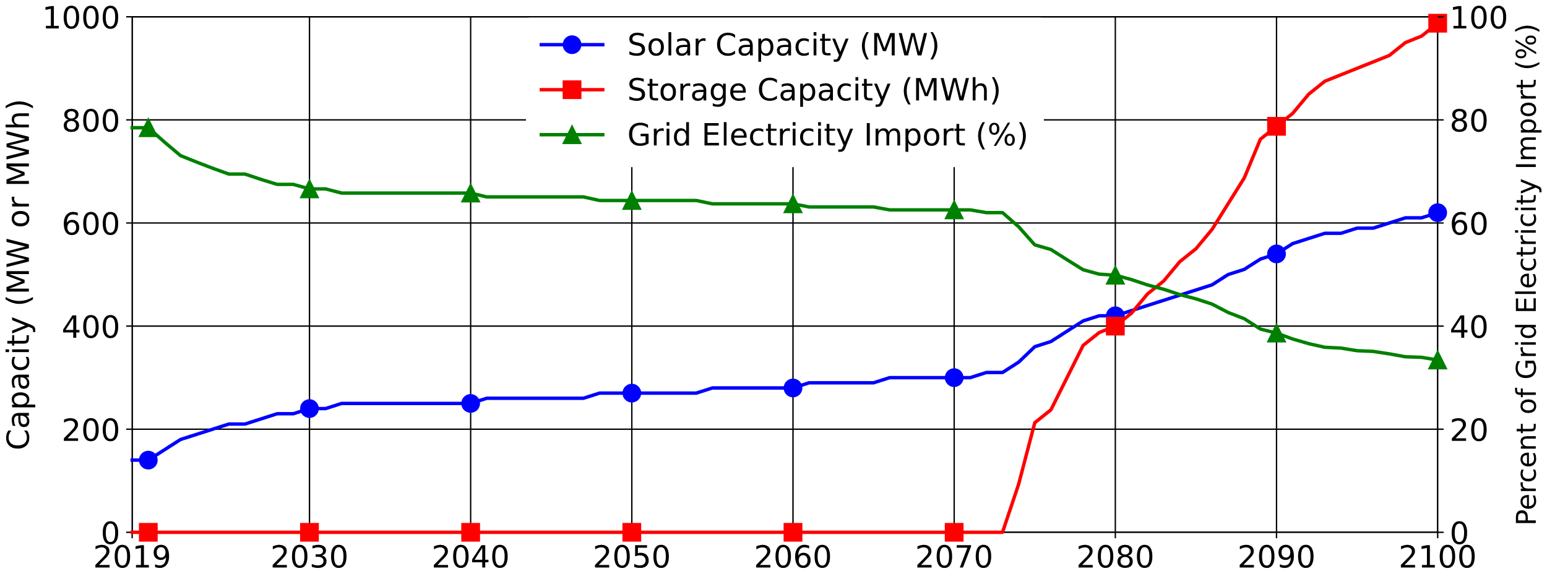
Sizing Method
9

Slide 26
Sizing Method
9

Slide 27
Design Space
Increasing solar size reduces grid electricity import. However, the reduction has a limit, as solar do not generate energy at night
For a particular solar size, increasing storage reduces grid electricity import. The initial reduction is large, but later reduction shows diminishing return
Small solar size cannot support independent energy system, the first solar size that can support the system also requires the largest storage
10

Slide 28
Future Trend
11

Slide 29
Conclusion
Currently
Solar PV is economically competitive, but lithium battery storage is still too expensive.
Future
Solar and storage will take up greater portion of the energy system, as their prices continue to drop.
However
Flexible grid electricity is needed, to meet some demands too costly for solar and storage.
12

Slide 30
Question and Contact
?
Contact
Han Kun Ren
University of Oxford
han.ren@eng.ox.ac.uk

